Slide 1
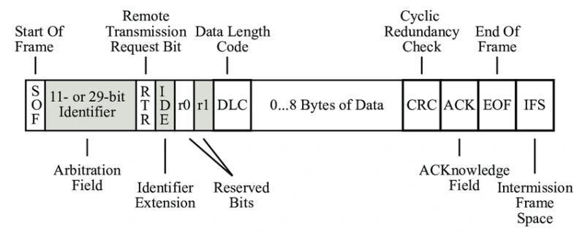
CAN FRAME :

Slide 2
IDLE State:
When there is no frame on the bus, the bus is in an IDLE state.
In the IDLE state, the bus has a recessive bit (logic 1).
Start of Frame (SOF):
Every data frame starts with a dominant bit called the Start of Frame (SOF).
SOF is 1 bit long and is always dominant (logic 0).
This bit informs all nodes about the start of a new frame on the bus, signaling that the bus is no longer idle and
synchronizing all receiving (Rx) nodes with the transmitting (Tx) node.

Slide 3
Message ID:
CAN is a message-based protocol where each frame is identified by a Message ID.
In a standard frame, the Message ID is 11 bits long.
Typically, the 11th and 4th bits are masked for complex reasons, resulting in 9 unique bits in the Message ID.
This allows for 2⁹ = 512 different CAN frames in a single CAN network, with the Message ID ranging from
hexadecimal 000 to 7FF.
Mentioned as Identifier in the above figure.
Remote Transmission Request (RTR):
After the Message ID, there is a single bit called the Remote Transmission Request (RTR).
RTR differentiates between a data frame and a remote frame:
RTR = 0: Data Frame
RTR = 1: Remote Frame

Slide 4
Reserved Bits:
Following the RTR bit are two reserved bits, R1 and R0.
These bits are always recessive and were originally intended for future enhancements of the CAN protocol.
Nowadays, R1 is used as the IDE bit to differentiate between Standard and Extended frames, while R0 is used as the FDF bit to differentiate between CAN and CAN-FD frames.
Data Length Code (DLC):
The next field is the Data Length Code (DLC), which indicates the number of bytes of data in the frame.
DLC is 4 bits long and can range from 0 to 8, allowing for up to 8 bytes of data.

Slide 5
Data Field:
Following the DLC is the actual data field, which contains the data bytes specified by the DLC.
The data field can contain a maximum of 8 bytes and a minimum of 0 bytes.
Checksum (CRC):
After the data field, there is a 15-bit CRC (Cyclic Redundancy Check) field used for error detection.
The transmitting node computes the CRC checksum and includes it in the frame.
The receiving node also computes its own checksum for the received data and compares it with the CRCfield. If they match, the frame is considered valid; otherwise, it is invalid.

Slide 6
CRC Delimiter (CD):
Following the CRC field is the CRC Delimiter, a single bit used to provide time for the receiver to validate the frame.
The CRC Delimiter is always recessive.
Acknowledgement (ACK):
The next field is the Acknowledgement (ACK) slot.
The transmitting node puts a recessive bit in the ACK slot.
All receiving nodes that successfully received and validated the frame will overwrite this bit with a dominant bit to acknowledge receipt.
If the transmitting node does not see a dominant bit in the ACK slot, it signals an acknowledgement error.

Slide 7
Acknowledgement Delimiter (AD):
Following the ACK slot is the Acknowledgement Delimiter, a single recessive bit.
End of Frame (EOF):
The EOF field consists of 7 consecutive recessive bits, marking the end of the frame.
Intermission (IFS):
The EOF field is followed by 3 bits of Intermission (IFS) or Interframe Space.
These 3 bits signify the end of the frame and the bus returning to the IDLE state.

Slide 8
What is Secure PDU ?
A Secure PDU (Protocol Data Unit) is a structured data packet that includes both:
Application data (like sensor values or commands)
Security metadata (like MAC tag, freshness value, flags)
It’s used to securely transmit data over in-vehicle communication buses like CAN or CAN FD.
Field | Description | Example Size
Header / Auth Info | May include reset flag, flags | 1–2 bytes
Freshness Value | A counter or timestamp to prevent replay | 4 bytes
MAC Tag | Authentication code (HMAC/CMAC) | 8–16 bytes
Payload (SDU) | Actual application data | 0–64 bytes (CAN/CAN FD)

Slide 9
Secure PDU will be sent over the CAN frame Data bytes.
MAC will be appended at the of the DATA frame and other function like freshness value and flag added at the start of DATA frame.
Workflow:
Freshness value -> Payload -> MAC=total 8 Bytes
The MAC is computed over the freshness + payload
Then it is added at the end of the PDU
The entire Secure PDU is sent over CAN or CAN FD
MAC have the size of 16 Byte or 32 Bytes. Can be reduced to 8 Bytes

